Slide 1
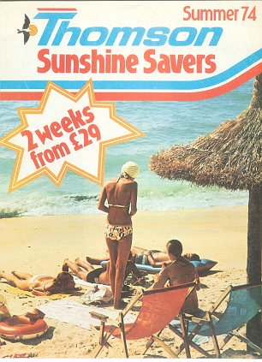
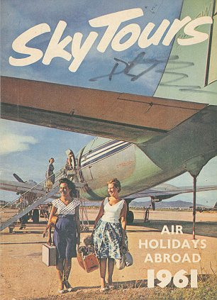
Key development from 1960s onwards that have shaped the present day travel and tourism sector.
By Ryan Mortimer

Slide 2
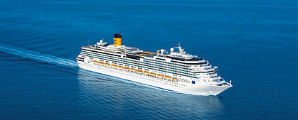
Introduction of Cruises
The growth of Cruising have increased alot since the 1960's because they have no split into different cruises such as the Caribbean.
They have done this because now the cruises can appeal to everybody and they are also one of the fastest selling holidays.
Cruises have become more popular over the years because on a cruise you can take your luggage with you and you don’t have to get off.
Since the 1960, Cruising has become very popular and is now one of the fastest growing industry's in Travel.
People like to go on cruises because they to visit loads of different destinations and experience new things.

Slide 3
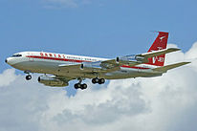
Introduction to jet aircraft
The introduction of reliable jet planes were founded in the 1960's.
The new planes offer customers the opportunity to travel the world and experience various destinations and allows you to travel places quicker and more efficiently. This would cost passengers a lot less then if they was to drive or travel by boat.
This means that people would be able to travel to more places a lot cheaper and faster and therefore more people will want to use the jet aircraft to travel.

Slide 4
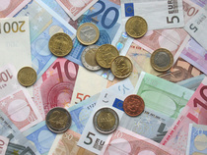
Introduction of the Euro currency
The euro will become legal if they aren't already in these 12 different countries; Germany, France, Spain, Portugal, Belgium, The Netherlands, Luxembourg, Italy, Greece, Finland, Austria and Ireland
You can tell the euro apart because the eight coins are different in size, different weights, the material is diffrent, colour, edge and thickness.
The euro has helped travelling within Europe as travellers can use the same currency through Europe. It is much easier as it doesn’t mean that travellers have to exchange their money constantly losing their money.

Slide 5
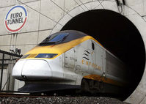
Opening of Channel Tunnel
The Channel Tunnel opened in 1994. There are 2 separate tunnels which are based next to each other. One is for cars and the other is a railway for the trains to pass through.
On 2 different occasions there was a fire in a lorry shuttle which has damaged the tunnel. One took place in 1996 and the other recently in 2008.
The Channel Tunnel is a quick and easier way for people want to take their cars overseas to France and back. It is also good for the Eurostar which is used by business people and travellers who want fast and easy access to France and Belgium by train.

Slide 6
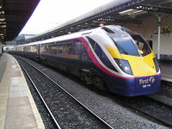
Privatisation of the British Rail
The Privatisation of the British Rail was first introduced towards the end of the 1980's.
At first they were part of the Public sector because they were owned by the government but since the 1980's the rails have been split up and they are now in separate groups of trains and they are now a Private Limited Company.
Companys such as Virgin are successfully operating the route between Manchester and London and people are very happy with the service they provide as they wish to make their rail service just like their airline.

Slide 7

Introduction of Expedia
The Expedia company was first started off by 2 men named Rich Barton and Lloyd Frind.
The Expedia is an internet-based travel reservation website. The Expedia company is located in the US and it has over 90 localised sites for a number of different countries and the website is also the single largest provider for hotel bookings all over the world.
The website contains over 130,000 hotels and hundreds of different airlines, tour operators, car rental companies and destination services.
There are now alot more internet Tour Operators therefore it is having a huge impact on high street Travel Agents because alot of them are having to shut down due to loss of profit.

Slide 8
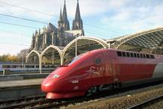
Introduction of High Speed Train network in Europe
High-speed rail is developing in Europe as an increasingly popular and effective way of transport. It was first built in the 1980s and since then several countries have built widespread high-speed networks.
High Speed Trains transport has helped the travel and tourism industry because it is allowing people to travel to different places at a cheaper price than flight prices.
Currently in the UK HS2 is being proposed and this will decrease the travel time from London to Manchester to 1 1/2 hours.
However there is alot of opposition to building a new rail line as it will disrupt peoples lives.

Slide 9
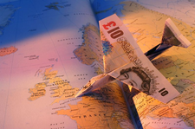
Introduction of APD (Airline Passenger Duty)
APD was introduced in 1994. In 1996 air passenger duty was reduced on economy flights.
This has become a huge part of inbound tourism in which is growing quickly.
APD is for anyone travelling from a UK airport in which there are four bands based on the distance from London to your destination in which are band A- 0-200 miles, band B-2001-4000, band C-4001-6000 and band D- over 600 miles in which you have to pay different rate for to travel.

Slide 10

Merger of Thomson Holidays and First Choice
Thomson holidays and First Choice decided to merge together because nowadays people are booking their holidays online therefore if they stayed at independent tour operators they would lose out on money so to increase their profitability they decided to merge together so their money income doesn’t decrease.
People have decided to trust the internet and book their holidays online because they see it as a quicker and easier way to book it than to sit in the travel agents for hours. Thomson is now part of TUI which is a large German owned tour operator.

Slide 11
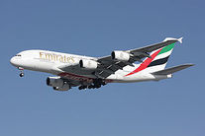
Introduction of super planes
The super plane airbus A380 took its first flight in 2005 and entered its first initial commercial service which companies like Emirates now having their own terminals which Emirates merging with 11 different airlines like Qantus to dominate air travel between Asia and Australia. The airbus A380 can hold up to 853 passengers at one time.
The super plane has a
fantastic effect on the travel industry as they can carry a lot more passengers than a normal aircraft and therefore won’t use as much fuel and money than it would to use 2 aircrafts.
However, it is more likely to attract business people going on long hour travel flights and wanting to rest or higher class passengers who want to have high quality services while they travel.

